Slide 1
the Section 7003 Payment Formula
Impact Aid Program
U.S. Department of Education

Slide 2
Teams Buttons
Participant list
Chat box
“Raise your hand” – click once to raise your hand, click again to put your hand down
Mute your video
Mute your microphone
Do not present your screen

Slide 3
Agenda
The IAGS Payment History Page
7003(b) Basic Support Calculation
7003(d) Children with Disabilities Calculation
Other Payments and Adjustments

Slide 4
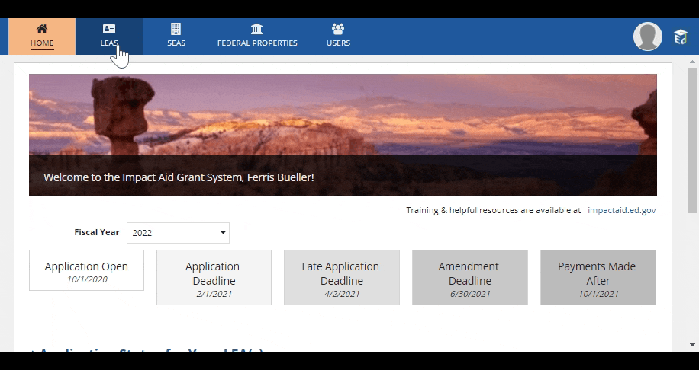
Finding Your Payment History
Click on
LEAs on the top menu
Click on
the Local Educational Agency
Click on
“Payment History” under the LEA’s name

Slide 5
THE IAGS PAYMENT HISTORY PAGE
Program Type
FEDERAL Fiscal Year
Amount
APPROXIMATE Date of Payment

Slide 6
Finding a Voucher

Slide 7
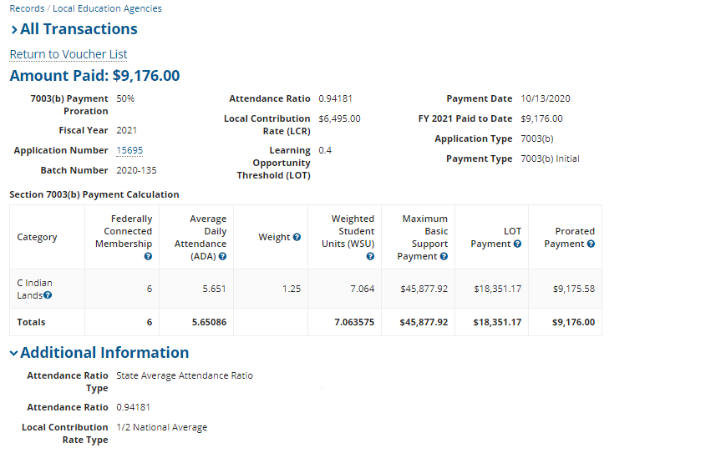
Formula Inputs: Basic Support Payments 7003(b)
Federally Connected Membership
Average Daily Attendance (ADA)
Weighted Student Units (WSU)
Local Contribution Rate (LCR)
Maximum Basic Support Payment (Max. BSP)
Learning Opportunity Threshold (LOT)
Payment Proration

Slide 8
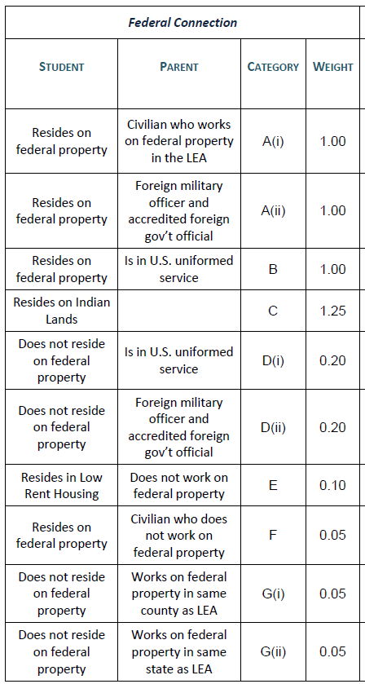
Categories of Federal Connection
Pro Tip: Hover over the blue question marks on the voucher for more information

Slide 9
MEMBERSHIP: Eligibility Considerations
An LEA is eligible to be paid for categories F and G if its has at least 10% or 1,000 in Average Daily Attendance.
Based on your current year membership, the IAGS grant application will tell you how many students you need in these two categories to be eligible for payment.
“F” Children:
Civilian Parents ONLY Living on Federal Land (not Indian Lands or Low Rent Housing)
“G” Children:
Civilian Parents ONLY Working on Federal Land

Slide 10
Basic Support Payment Formula
Each step involves MULTIPLICATION, and the multiplier will be in the top section of your voucher, directly under the amount paid.

Slide 11
STEP ONE: Average Daily Attendance
Membership
ADA
Attendance Ratio

Slide 12
The Attendance Ratio
If multiplied by 100, represents the percentage of the LEA’s total enrollment attending school on a given day
State Attendance Ratios posted online
https://impactaid.ed.gov/resources/
First link under General Information
If your LEA’s attendance ratio is higher than the state rate, you may report your own on your application
Actual average daily attendance for the prior school year
Sampled average daily attendance for the prior school year

Slide 13
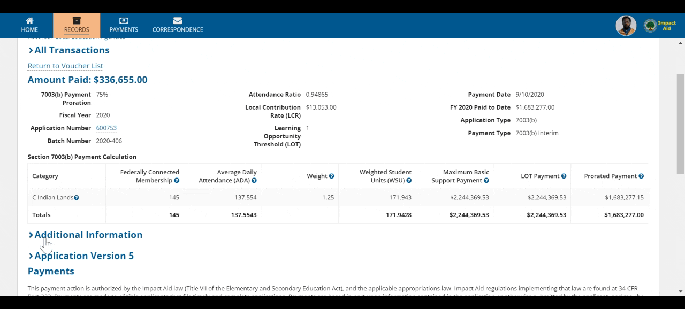
Finding The Attendance Ratio Type
Click on Additional Information

Slide 14
Calculating ADA

Slide 15
Step Two: Weighted Student Units
ADA
WSU
Weight

Slide 16
Calculating WSU

Slide 17
Step Three: Maximum Basic Support Payment
WSU
Max BSP
LCR

Slide 18
The Local Contribution Rate
Represents the LEA’s share of overall educational cost
Greater of the available options:
Half of the national average of per pupil expenditures
Half of the state average of per pupil expenditures
Local Contribution Percentage
Generally Comparable District
Find the option your LEA is receiving under Additional Information

Slide 19
Calculating Max BSP

Slide 20
STEP Four: lEARNING OPPORTUNITY THRESHOLD
Max BSP
LOT Payment
LOT

Slide 21
Calculating the Learning Opportunity Threshold (LOT)
LOT % =
Membership %
+
TCE %
Membership % =
Total Eligible Federally Connected Children
/
Total Membership
TCE % =
Total Max BSP
/
Total Current Expenditures
X
100
X
100
*Cannot exceed 100%, or 1

Slide 22
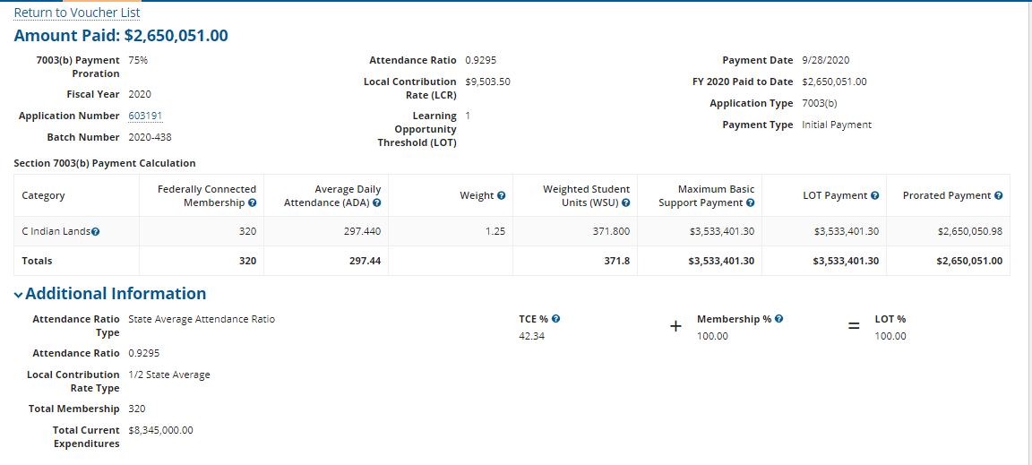
Calculating the LOT Payment
COLOR KEY
Green: Relates to TCE %
Black: Relates to Membership %
Blue: Relates to LOT %

Slide 23
“Small LOT” Districts
Have fewer than 1,000 students in Average Daily Attendance
LEA’s per pupil expenditures are less than State or National per pupil expenditures
Receive a LOT of 0.4, or 40%

Slide 24
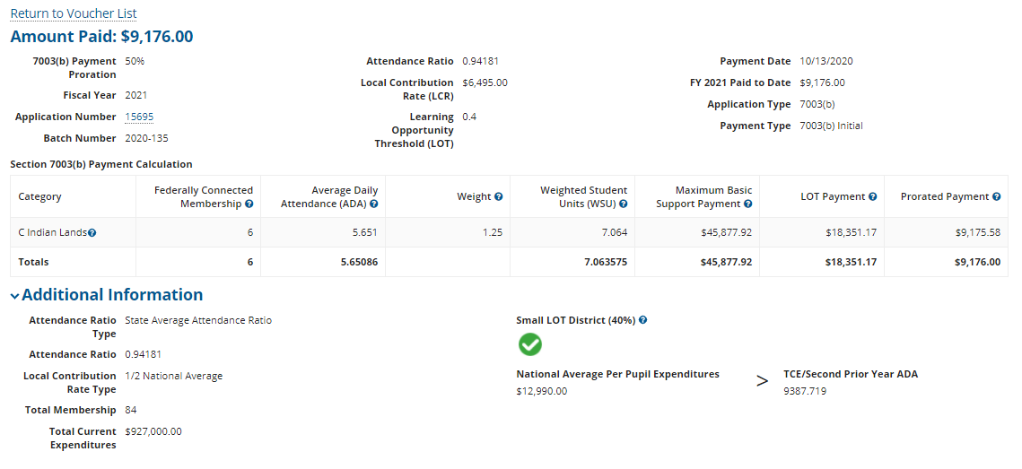
Small LOT District Vouchers

Slide 25
STEP FIVE: PRORATION
LOT Payment
Prorated Payment
Payment Proration

Slide 26
Calculating the Prorated Payment

Slide 27
Children with Disabilities PAYMENTS
Under 7003(d)
AKA “CWD” Payments

Slide 28
Formula Inputs Children with Disabilities 7003(d)
Membership
Average Daily Attendance (ADA)
Weighted Student Units (in the law)
CWD Rate

Slide 29
Only children with an Active IEP, who are military-connected or who live on Indian lands, generate an additional payment for Children with Disabilities under 7003(d).

Slide 30
THE CWD Payment Formula

Slide 31
STEP ONE: Average Daily Attendance
Membership
ADA
Attendance Ratio

Slide 32
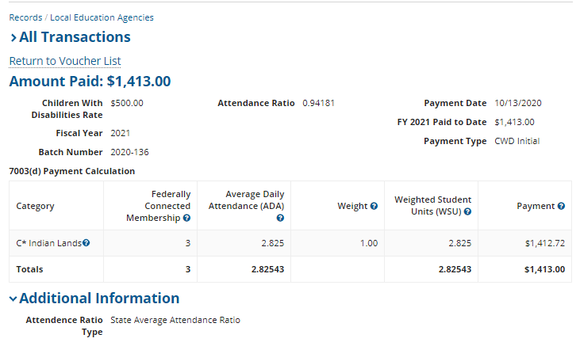
Calculating CWD ADA

Slide 33
Step Two: Weighted Student Units
ADA
WSU
Weight

Slide 34
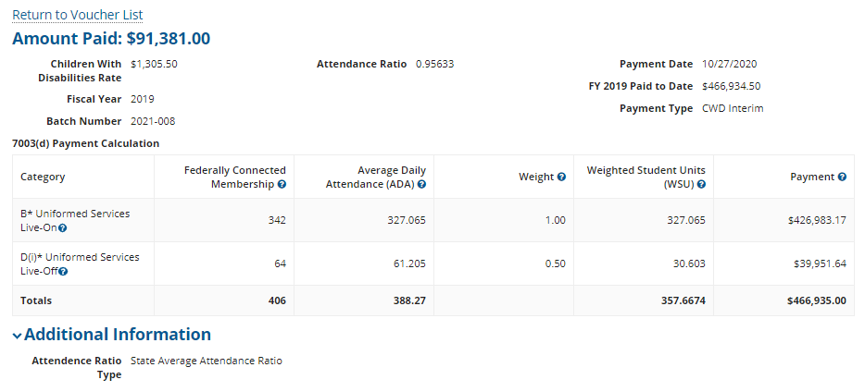
Calculating CWD WSUs

Slide 35
Step Three: CWD Rate
WSU
CWD Payment
CWD Rate
The CWD Rate is determined by totaling all LEA’s eligible CWD WSU, and dividing the funds appropriated for CWD equally among them.

Slide 36
Calculating the CWD Payment

Slide 37
Other Payments and adjustments
Late Applications
Heavily Impacted Payments
Hold Harmless under 7003(e)
Overpayments and Offsets

Slide 38
Reduction for Late Applications
Applications submitted within 60 days after the application deadline are assessed a 10% penalty on all payments arising from the late application.

Slide 39
7003(e) Hold Harmless
If your LEA’s final calculated basic support payment dropped by more than 20% when compared to your final calculated payment for the prior fiscal year, Section 7003(e) guarantees the LEA a certain percentage of your prior year basic support payment.
“Step Down”
90% of prior year payment for the first year the LEA experiences a 20% drop
85% of calculated prior year payment if another 20% drop happens the following year
80% of calculated prior year payment if another 20% drop happens for a third year in a row
The final voucher will show your hold harmless increase (the amount you are receiving in excess of your calculated payment as a result of the hold harmless) and whether the LEA is in year 1, 2 or 3 of the step down.

Slide 40
Heavily Impacted Vouchers Will Show
The payment calculated under Basic Support 7003(b)(1) at the current proration, as usual
The Heavily Impacted Maximum payment calculation under 7003(b)(2)
Second prior year ADA with B2 payment weights
B2 LCR
Heavily Impacted Prorated Payment, applying the same proration as the (b)(1) payment

Slide 41
Overpayments (Receivables) and Offsets
New calculated payment is $3
District has been paid $5
District receives a voucher for a ($2) payment
$2 is subtracted from district’s next payment(s)
Application data is changed
Sometimes data adjustments can result in a calculated payment that is lower than the funds the district has already received for the fiscal year
Voucher will show
The current calculated payment
The amount the district has already received
The difference as a negative payment
Payment history page will show any outstanding receivables
Receivables will be offset (subtracted) from subsequent Impact Aid payments

Slide 42
Question Time
Impact.Aid@ed.gov
202-260-3858
impactaid.ed.gov

